Slide 1
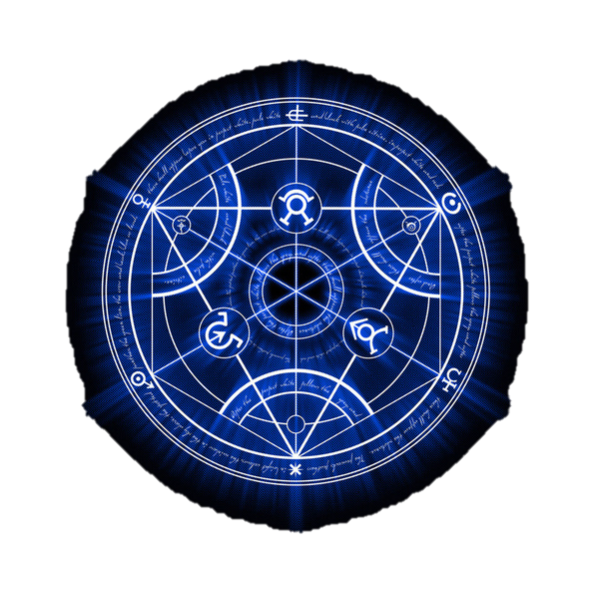
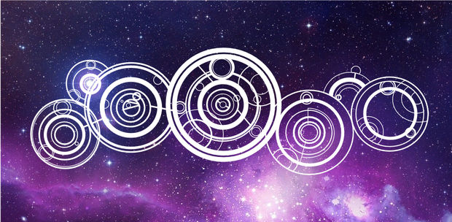
Chapter 11 Test Review

Slide 2
It’s easy! All you have to do is….

Slide 3
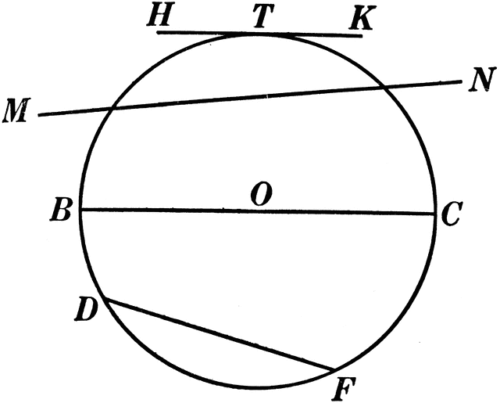
Which best describes DF?
(Diameter, Radius, Secant, Tangent, Chord)
**10 multiple choice questions, 8 “work out” problems**

Slide 4
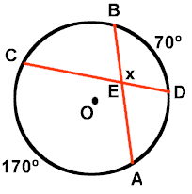
2. What is the measure of x?

Slide 5
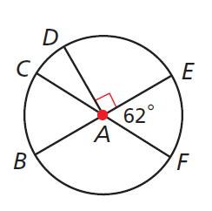
3. What is the measure of arc BDF?

Slide 6
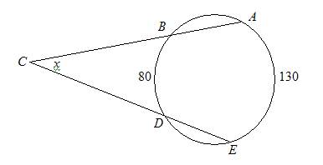
4. What is the value of x?

Slide 7
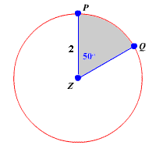
5. What is the area of sector PZQ in terms of $π$?

Slide 8
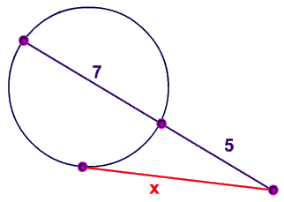
6. What is the value of x?

Slide 9
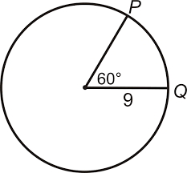
7. What is the length of arc PQ in terms of $π$?

Slide 10
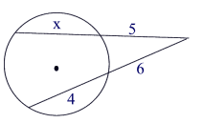
8. What is the value of x?

Slide 11
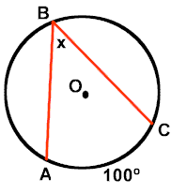
9. What is m∠B?

Slide 12
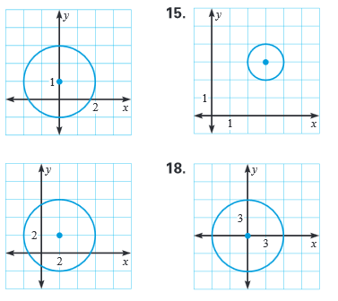
10. Which is the graph of $x^{2}+{\left(y−1\right)}^{2}=4$?

Slide 13
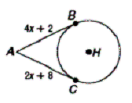
11. $\overline{AB}$ and $\overline{AC}$ are tangent segments. Find $\overline{AC}$
**Here’s where the “work out” problems start

Slide 14
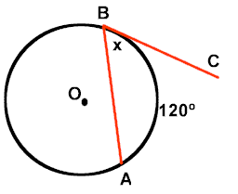
12. m ∠ ABC = ________

Slide 15
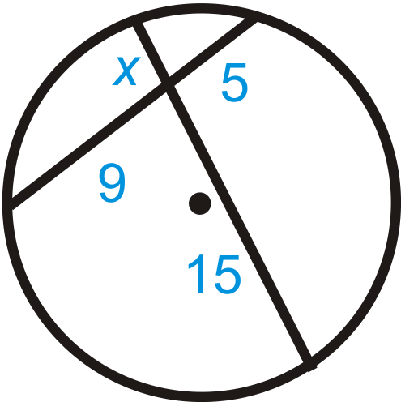
13. AB = ________
A
D
C
B

Slide 16
14. Identify the center and radius of the circle with the equation

Slide 17
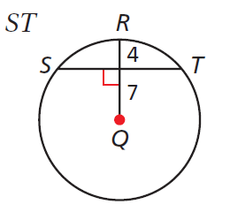
15. ST = ________ (Hint: What is the radius? You will need to use the Pythagorean Theorem)

Slide 18
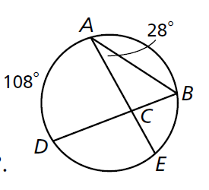
16. m ∠ BCE = _____ (Hint: First, find the measure of $\hat{BE}$)

Slide 19
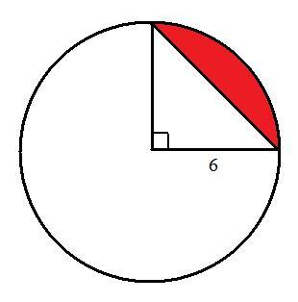
17. Find the area of the segment of the circle. Leave $π$in your answer. (Hint: Area of the Sector – Area of the Triangle)

Slide 20
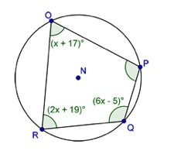
18. m ∠ QRO = _____

Slide 21
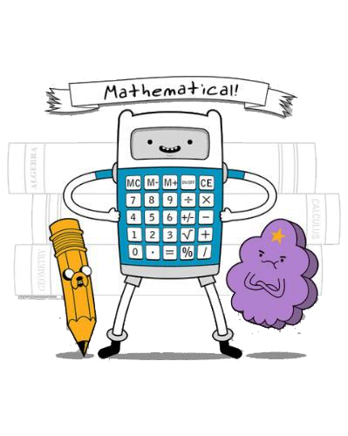
Don’t forget your calculator tomorrow!!!

Slide 22
Which best describes DF?
(Diameter, Radius, Secant, Tangent, Chord)
Secant
**10 multiple choice questions, 8 “work out” problems**

Slide 23
2. What is the measure of x?
$\frac{170+70}{2}$
$$= \frac{240}{2}$$
$$= 120°$$

Slide 24
3. What is the measure of arc BDF?
arc BDF = arc BDE + arc EF
arc BDF
= $180 + 62$
arc BDF
= $242°$

Slide 25
4. What is the value of x?
$$x=\frac{m\hat{AE} −m\hat{BD} }{2}$$
$$x= \frac{130 −80}{2}$$
$$x= \frac{50}{2}$$
$$x=25°$$

Slide 26
5. What is the area of sector PZQ in terms of $π$?
$$πr^{2}\left(\frac{\text{m}\text{∠}PZQ}{360}\right)$$
$$= π{\left(2\right)}^{2}\left(\frac{50}{360}\right)$$
$$= π\left(\frac{200}{360}\right)$$
$$= \frac{5}{9}π$$

Slide 27
6. What is the value of x?
$$\left(7+5\right)\left(5\right)=x^{2}$$
$$60=x^{2}$$
$$x= \sqrt{60}$$
$$x=4\sqrt{15}$$
or $≈$7.75

Slide 28
7. What is the length of arc PQ in terms of $π$?
$$2πr\left(\frac{\text{m}\text{∠}}{360}\right)$$
$$=2π9\left(\frac{60}{360}\right)$$
$$=18π\left(\frac{1}{6}\right)$$
$$=3π$$

Slide 29
8. What is the value of x?
$$\left(4+6\right)\left(6\right)=(x+5)(5)$$
60 $=5x+25$
35 $=5x$
x = 7

Slide 30
9. What is m∠B?
$m\text{∠}$B = $\frac{100}{2}$
$$=50°$$

Slide 31
10. Which is the graph of $x^{2}+{\left(y−1\right)}^{2}=4$?
Radius = $\sqrt{4}$
= 2
Center = ( 0, 1 )

Slide 32
11. $\overline{AB}$ and $\overline{AC}$ are tangent segments. Find $\overline{AC}$
$$4x+2=2x+8$$
$$2x=6$$
$x=$ $3$
$$\overline{AC}=2(3)+8$$
$$\overline{AC}=14$$
**Here’s where the “work out” problems start

Slide 33
12. m ∠ ABC = ________
$m\text{∠}\text{A}$BC = $\frac{120}{2}$
$$=60°$$

Slide 34
13. AB = ________
$$x•15=9•5$$
A
D
$$15x=45$$
$x=$ $3$
$$AB=\left(3\right)+15$$
C
$$AB=18$$
B

Slide 35
14. Identify the center and radius of the circle with the equation
Radius = $\sqrt{49}$
= 7
Center = ( -1, 5 )

Slide 36
15. ST = ________ (Hint: What is the radius? You will need to use the Pythagorean Theorem)
Radius = 4 + 7
= 11
x
7
11
$$7^{2}+x^{2}={11}^{2}$$
$$49+x^{2}=121$$
$$x^{2}=72$$
$$x=\sqrt{72}$$
$$x=6\sqrt{2 } or ≈8.49$$
$$ST=2(6\sqrt{2 }) or 2(8.49)$$
$$ST=12\sqrt{2 } or 16.98$$

Slide 37
16. m ∠ BCE = _____ (Hint: First, find the measure of $\hat{BE}$)
$$\hat{BE}=\frac{28}{2}$$
$$\hat{BE}=56°$$
$$m\text{∠}BCE=$$
$$\frac{108+56}{2}$$
$$= \frac{164}{2}$$
$$=82°$$

Slide 38
17. Find the area of the segment of the circle. Leave $π$in your answer. (Hint: Area of the Sector – Area of the Triangle)
Area of the Sector:
Area of the Triangle:
$$πr^{2}\left(\frac{\text{m}\text{∠}}{360}\right)$$
$$A= \frac{1}{2}bh$$
$$= π{\left(6\right)}^{2}\left(\frac{90}{360}\right)$$
$$A= \frac{1}{2}(6)(6)$$
$$= π\left(\frac{3240}{360}\right)$$
$$A=18$$
$$=9π$$
Area of the Sector:
$$9π −18$$

Slide 39
18. m ∠ QRO = _____
$$\left(x+17\right)+\left(6x−5\right)=180$$
$$7x+12=180$$
$7x=1$68
$$x=24$$
$m\text{∠ }\text{QRO}$ = $2\left(24\right)+19$
$m\text{∠ }\text{QRO}$ = $67°$

