Slide 1
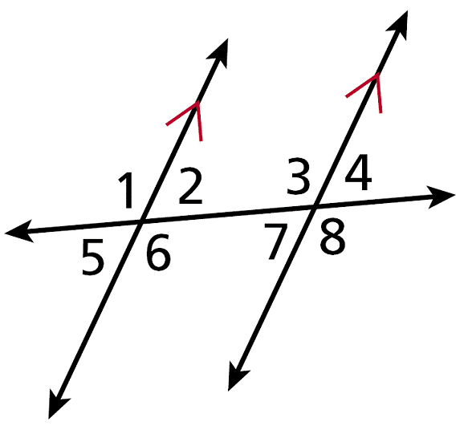
Warm Up
1. Identify the pairs of alternate
interior angles.
2. Use your calculator to find tan 30° to the nearest hundredth.
3. Solve . Round to the nearest hundredth.
∠2 and ∠7; ∠3 and ∠6
0.58
1816.36

Slide 2
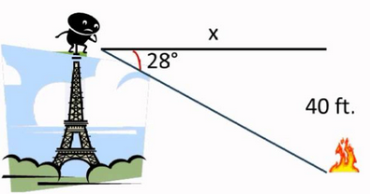
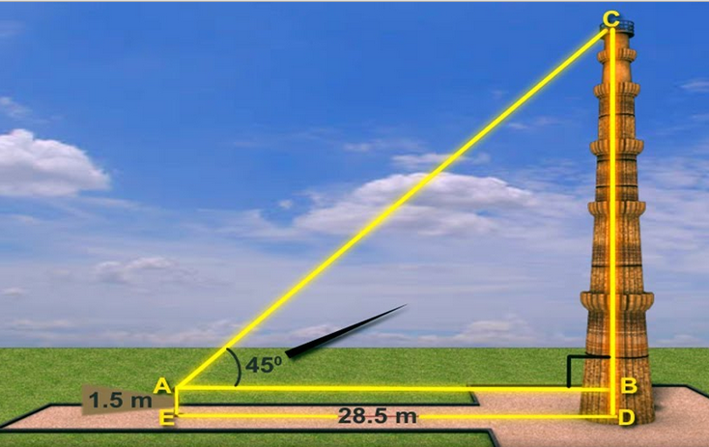
Tonight’s Homework: 02/16/16
Elevation/Depression worksheet

Slide 3
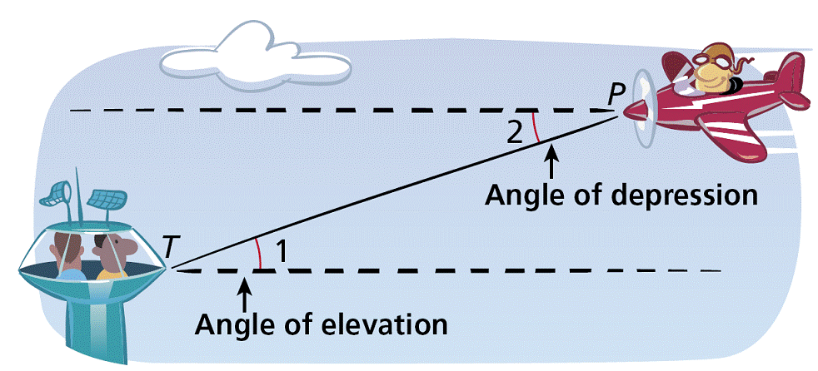
An angle of elevation is the angle formed by a horizontal line and a line of sight to a point above the line. In the diagram, ∠1 is the angle of elevation from the tower T to the plane P.
An angle of depression is the angle formed by a horizontal line and a line of sight to a point below the line. ∠2 is the angle of depression from the plane to the tower.

Slide 4
Since horizontal lines are parallel, ∠1 ≅ ∠2 by the Alternate Interior Angles Theorem. Therefore the angle of elevation from one point is congruent
to the angle of depression from the other point.

Slide 5
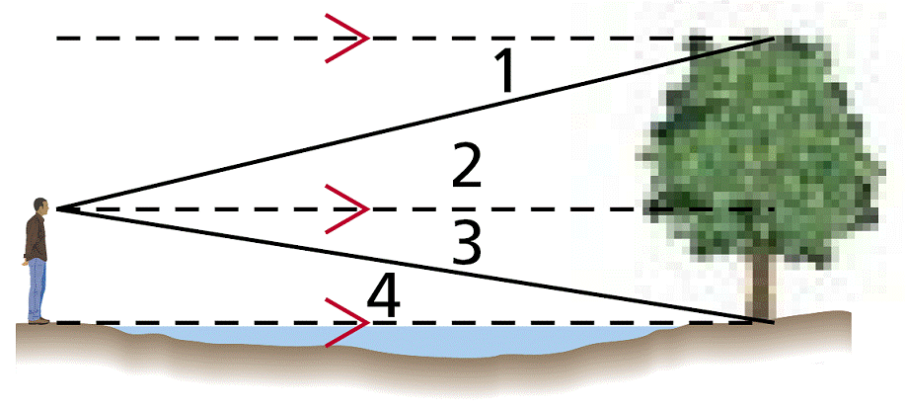
Example 1: Classifying Angles of Elevation and Depression
Classify each angle as an angle of elevation or an angle of depression.

Slide 6
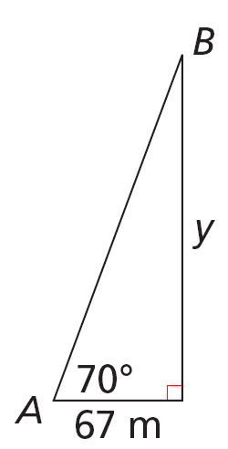
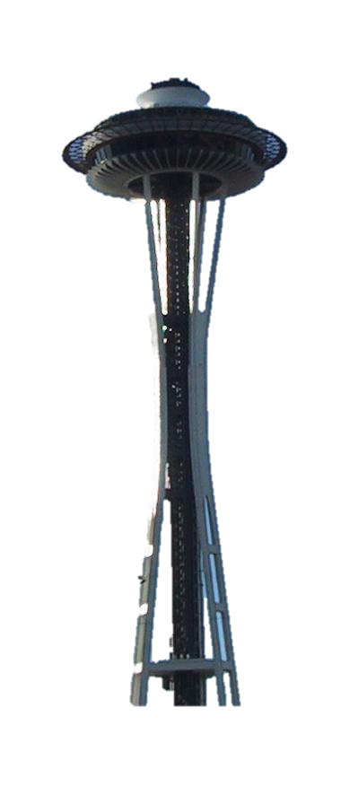
Example 2: Finding Distance by Using Angle of Elevation
The Seattle Space Needle casts a 67-meter shadow. If the angle of elevation from the tip of the shadow to the top of the Space Needle is 70º, how tall is the Space Needle? Round to the nearest meter.

Slide 7
Example 3: Finding Distance by Using Angle of Depression
An ice climber stands at the edge of a crevasse that is 115 ft wide. The angle of depression from the edge where she stands to the bottom of the opposite side is 52º. How deep is the crevasse at this point? Round to the nearest foot.

Slide 8
Example 4
What if…? Suppose the ranger sees another fire and the angle of depression to the fire is 3°. What is the horizontal distance to this fire? Round to the nearest foot.
3°

Slide 9
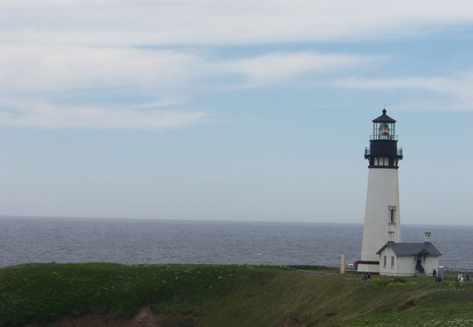
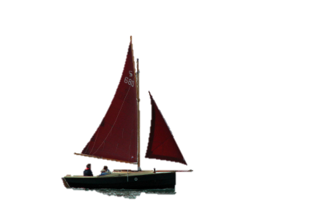
Example 5: Shipping Application
An observer in a lighthouse is 69 ft above the water. He sights two boats in the water directly in front of him. The angle of depression to the nearest boat is 48º. The angle of depression to the other boat is 22º. What is the distance between the two boats? Round to the nearest foot.

Slide 10
Example 5 Continued
Step 2 Find y.

